Slide 1
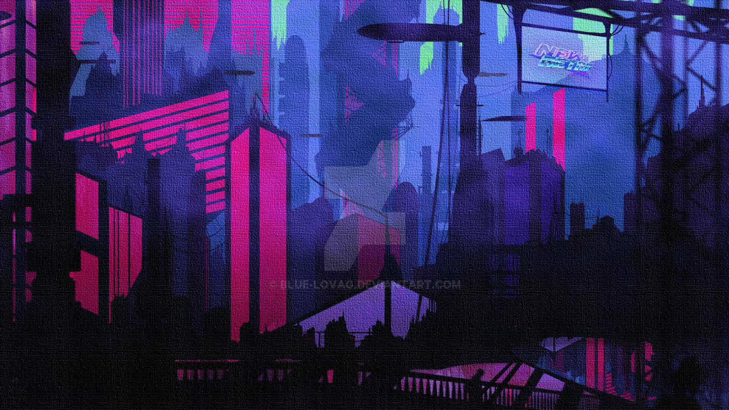
Introduction to Programming
How to get started with Programming
Instructor: Rajat Kumar Rai
therajatraiofficial@gmail.com
Lecture 01
Introduction to Programming

Slide 2
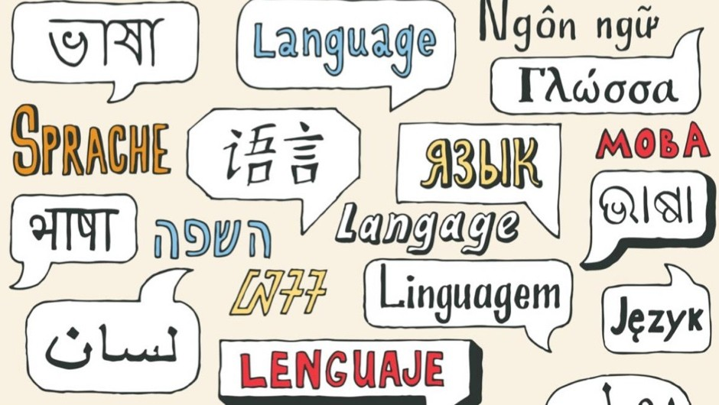
The Story of a Language
Language, a system of conventional spoken, manual (signed), or written symbols by means of which human beings, as members of a social group and participants in its culture, express themselves.

Slide 3
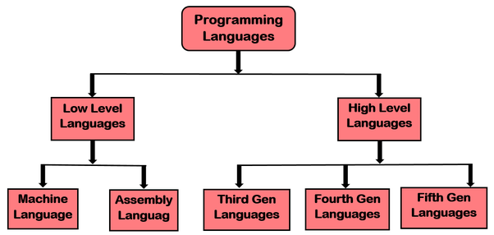
What is a Computer Language ?
0101000001010101010101010101010101010101010101

Slide 4
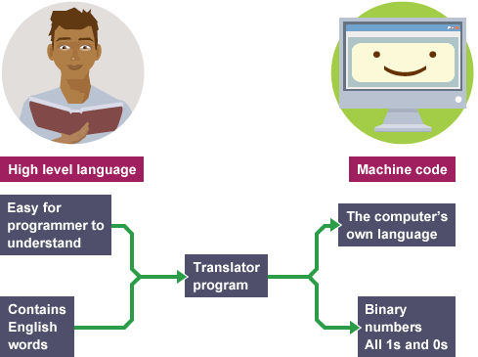
Computers Don’t Understand Our Language

Slide 5
Our Language in this Case is the Programming Language
What can this language “do”?
The answer is very simple: all languages can “do” exactly the same computations!
Then why many languages ?

Slide 6
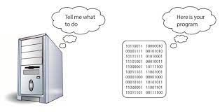
Program & Programming Language
A program is a sequence of symbols that specifies a computation. A programming language is a set of rules that specify which sequences of symbols constitute a program, and what computation the program describes.

Slide 7
The Translators
Assembler
Interpreter
Compiler

Slide 8
A compiler is a software that converts programs written in a high level language into machine language.
An interpreter is a software that translates a high level language program into machine language.
An assembler is a software that converts programs written in assembly language into machine language.
What ?
Compiler converts the whole high level language program to machine language at a time.
Interpreter converts the high level language program to machine language line by line.
In contrast, assembler converts assembly language program to machine language.
How ?

Slide 9
Any Questions ?

